Slide 1




PwC – Digital Intelligence
(Virtual Case Experience)
Task 5 – Predictive Health Care
Data Team:
Akshay Paunikar (Data Scientist)
Jakob (Senior Data Scientist)

Slide 2
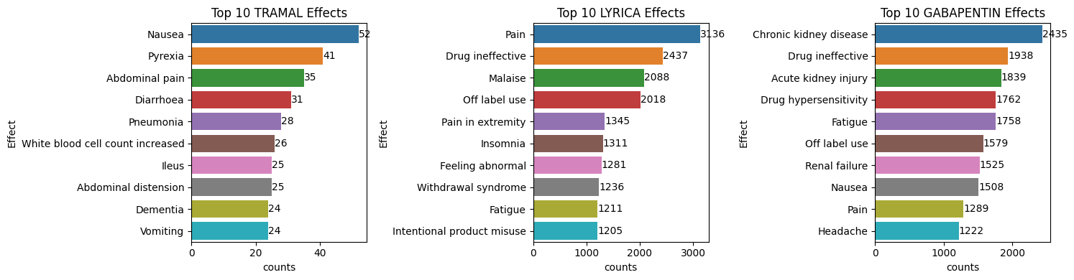


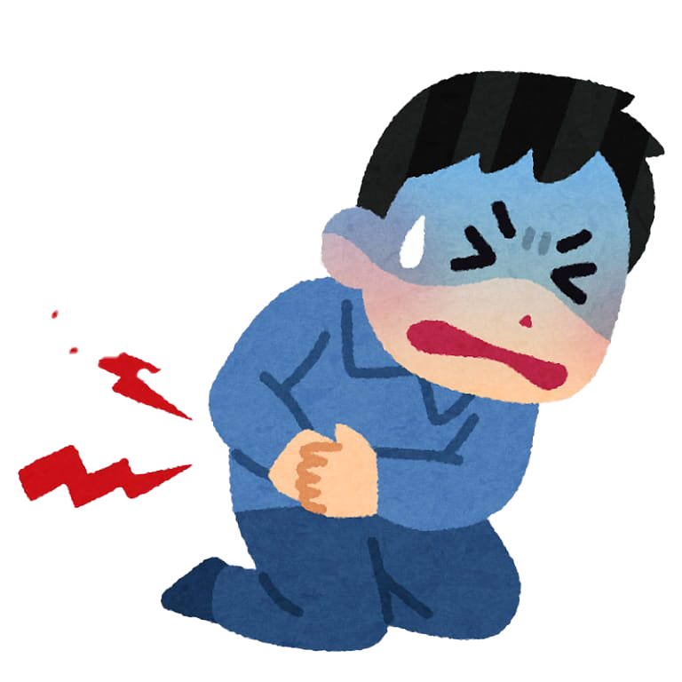

Top 10 Adverse Effect of Drugs

Slide 3
Comparison of drugs
Top Adverse Effects of TRAMAL
Nausea
Pyrexia
Abdominal Pain
Top Adverse Effects of LYRICA
Pain
Drug Ineffective
Malaise
Top Adverse Effects of GABAPENTIN
Chronic Kidney Disease
Drug Ineffective
Acute Kidney injury
The top two adverse effects of Lyrica seem to indicate, that a patient visits the doctor again because of sense pain and/or because of the feeling that the drug might not work as intended. This could be an indication that Lyrica might not be a proper drug against pain in many occasions.
The top adverse effects of Gabapentin are Chronic Kidney Disease, Drug Ineffective, Acute Kidney Injury which seems very serious as compared to the other two drugs. Hence, this indicates that Gabapentin is not a proper drug against the pain in many occasions.
On the other side, adverse effects of Tramal seem to show, that many patients get nausea. Considering the fact, that Tramal is usually prescribed for severe pain and that “pain” is not listed in the adverse effects, the conclusion can be made, that Tramal is actually working as intended. However, it also seems that there are more severe adverse effects that might prevent patients to take the drug long term.

Slide 4


Further Investigations
Issue 1
What was the drug initially prescribed for? Does the adverse effects differs depending on that?
Issue 2
Are there any adverse effects resulting from co-medications?
Issue 3
Do adverse effects of drugs depend on other factors such as demographic data of the patient?
Issue 4
What are the long term vs short term adverse effects of the drugs?
Several issues need a closer look
Issue 5
Can adverse effects be treated by other drugs? In case of TRAMAL, a medication for nausea or pyrexia?
Issue 6
What is the severity of the adverse effects on the overall well-being of the patient?
Issue 7
Are certain adverse effects reported more than others and does that bias the data?
Issue 8
Can all casual adverse effects (especially long-term) be linked to current drug use?

Slide 5


